Slide 1
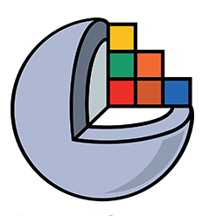
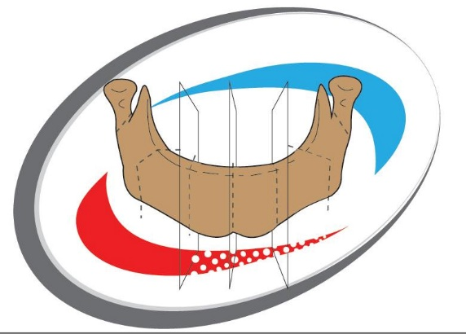
Slicer as a prototyping, versatile medical research software
BoneReconstructionPlanner: A 3D Slicer extension for virtual surgical planning of mandibular reconstruction with vascularized fibula free flap and generation of patient-specific surgical guides.
Corresponding paper: https://www.sciencedirect.com/science/article/pii/S2666964123000103
2021: Initial development as final project: Mauro I. Dominguez, Supervision: Andras Lasso
2022-2023: Maintenance and Improvements: Mauro I. Dominguez, Occasional recommendations: Andras Lasso

Slide 2
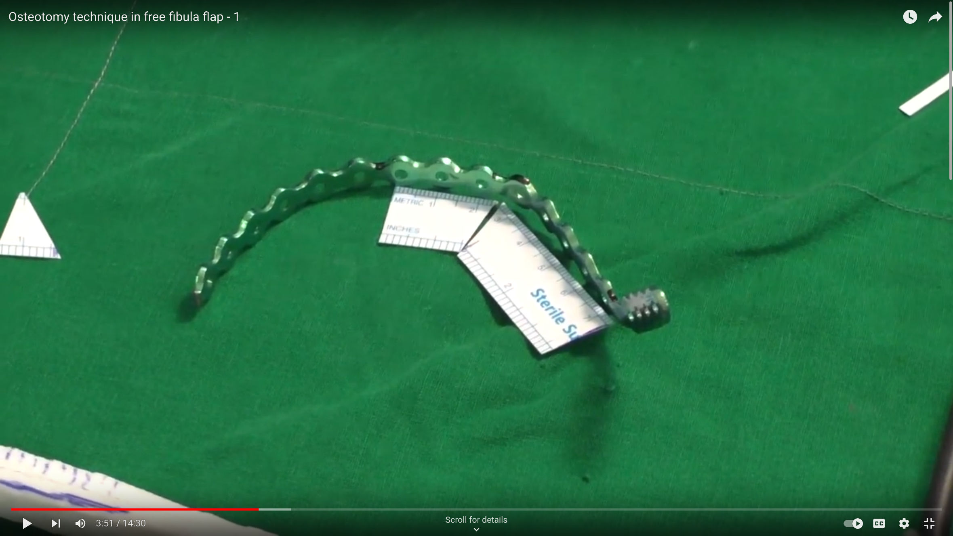
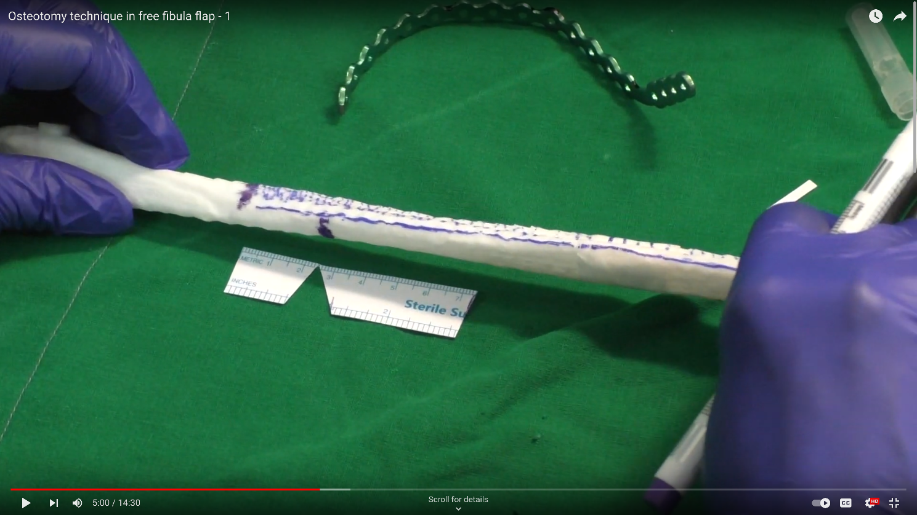
Eyeballing, the traditional paper-ruler method
Bend reconstruction plate according to resected mandible
Cut the rectangular paper ruler to pieces that match the reconstruction plate
Align the paper pieces along the grafted fibula and mark the closing-wedge osteotomies
Source: https://www.youtube.com/watch?v=O2tHpkxZ1F0

Slide 3
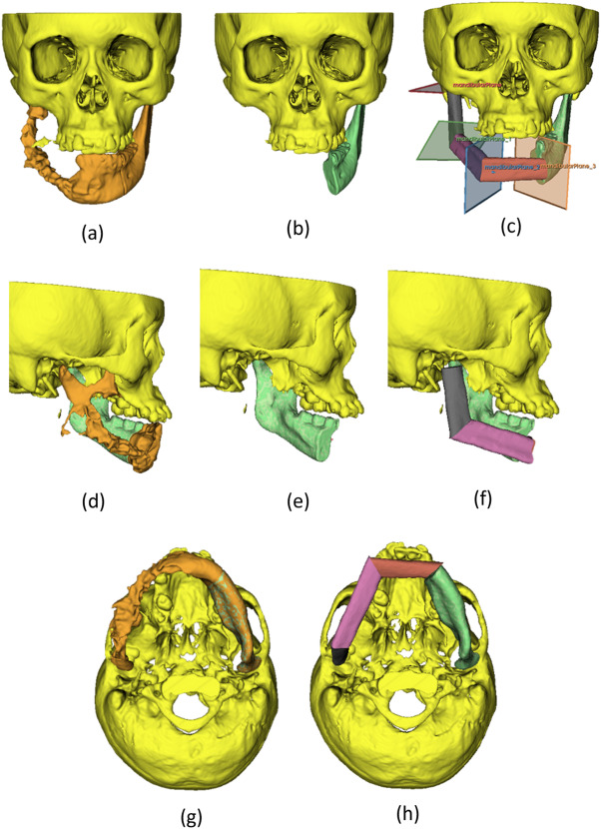
Virtual Surgical Planning, the digital way
Virtual surgical planning (VSP) - segmentation and mandible reconstruction
Segmentation of mandible. Noted mandible is separated from the midface and appear in a different colour.
Tumour resection is done virtually.
Placement of mandibular cutting planes and reconstruction
Lateral view of mandible segmentation.
Lateral view post-resection.
Lateral view post-reconstruction.
Bottom view of mandible segmentation
Bottom view post-reconstruction.
Source: https://www.sciencedirect.com/science/article/pii/S2666964123000103

Slide 4
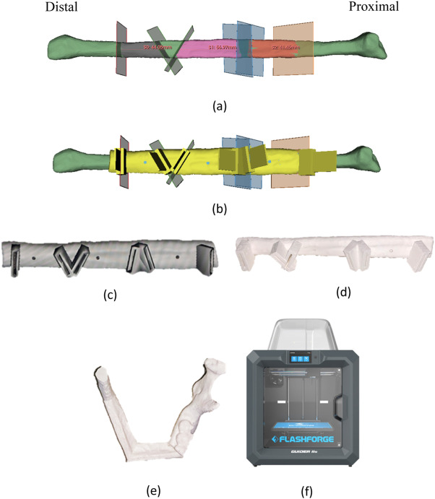
Virtual Surgical Planning, the digital way
VSP – fibula cutting guide generation
Fibula bone segmentation with the placement of fibula planes.
Generation of fibula cutting guide.
Fibula cutting guide in STL format
3D printed fibula cutting guide using PLA materials.
3D printed reconstructed mandible.
3D printer.
Source: https://www.sciencedirect.com/science/article/pii/S2666964123000103

Slide 5
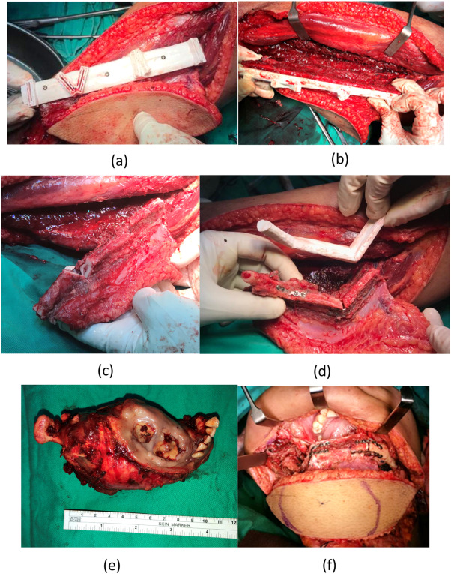
Virtual Surgical Planning, the digital way
Intra-operative photos (Case 1).
Fibula cutting guide fixed on to the fibula
Fitting of fibula cutting guide at the anterior and lateral aspect of the fibula.
Osteotomy cuts made. The fibula bone is cut into 3 segments.
Miniplates were fixed onto the fibula segments. Pedicles are still attached at this moment.
The main tumour was resected.
Fibula segments were fixed onto the native mandible to form neomandible.
Source: https://www.sciencedirect.com/science/article/pii/S2666964123000103

Slide 6
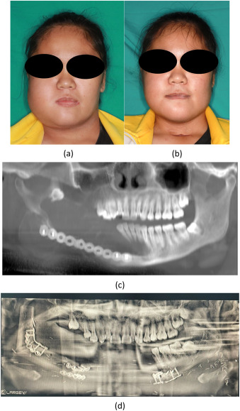
Virtual Surgical Planning, the digital way
Clinical photos (case 1).
Pre-operative facial appearance.
1-month post-operative facial appearance.
Pre-operative orthopantomogram.
1-month post-operative orthopantomogram.
Source: https://www.sciencedirect.com/science/article/pii/S2666964123000103

Slide 7
Virtual Surgical Planning, the digital way
Demo Video: https://youtu.be/HRciwWEOAKk?t=1

Slide 8
Virtual Surgical Planning, the digital way
Benefits:
less operation time
less ischemic time
less length of hospital stay after surgery
better osteotomies accuracy
better neomandible contour, more aesthetic
Cons:
VSP software license (free if using BoneReconstructionPlanner, 15k USD annual license if using commercial software)
3D printer, biocompatible material, sterilization (can be done on an in-house 3D printing lab or outsourced)
needs research-review-board or FDA approval
half an hour preoperative plan (plenty net time is still saved)
learning curve for new user or need of biomedical engineer or qualified technician
Source: https://www.sciencedirect.com/science/article/pii/S2666964123000103

Slide 9
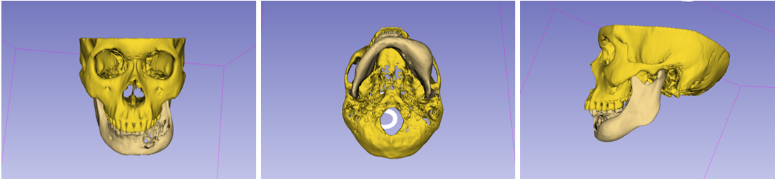
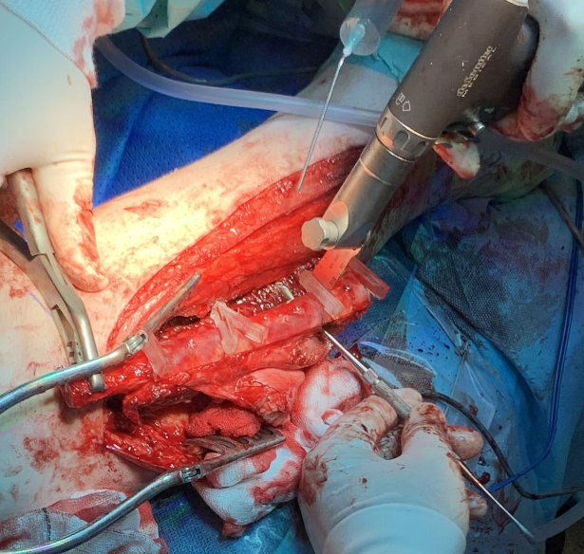
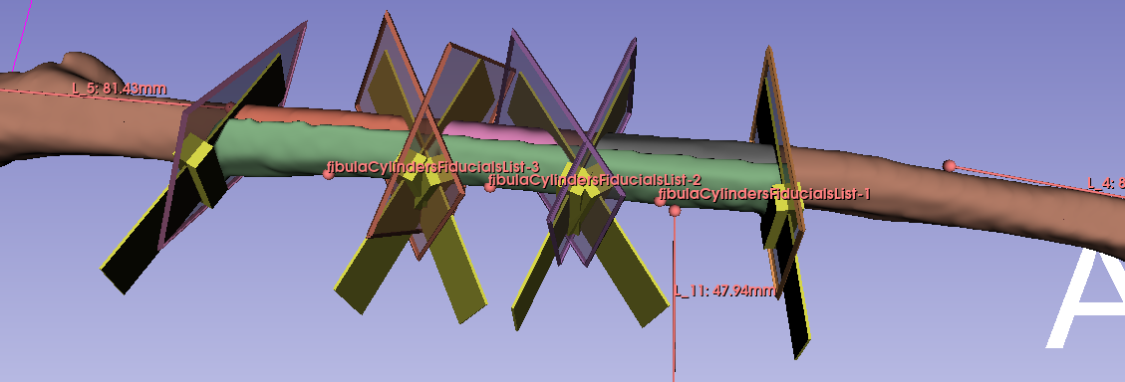
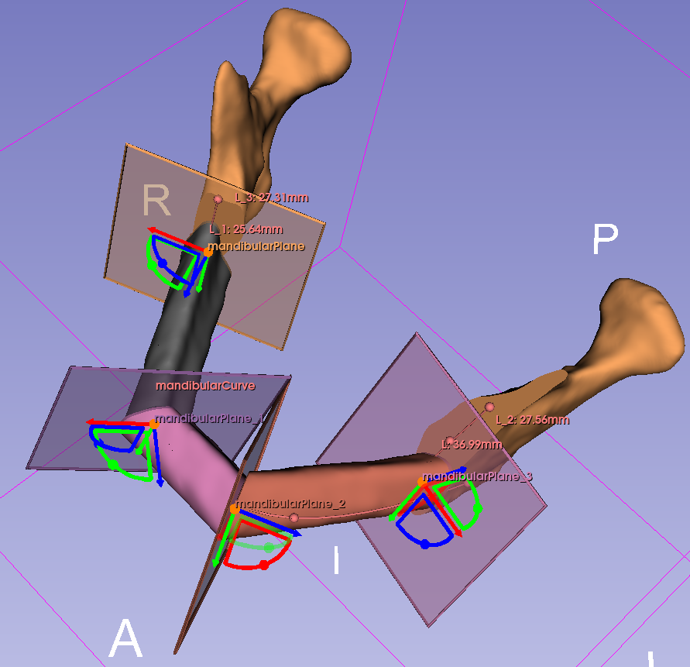
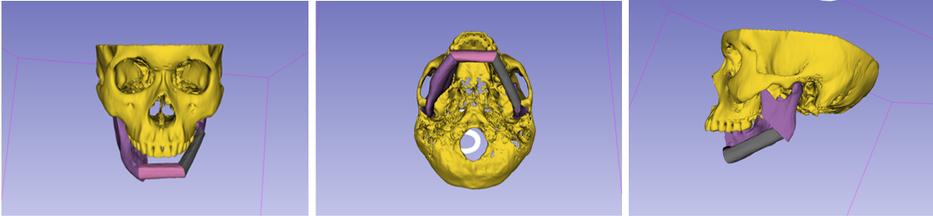
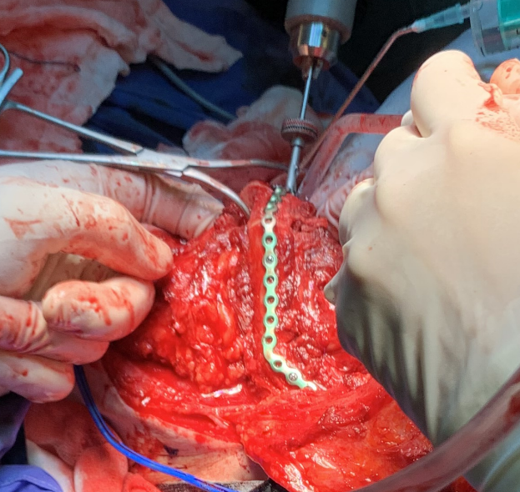
Virtual Surgical Planning, the digital way
Use cases: around 30 surgeries informally documented
Sources:
https://github.com/SlicerIGT/SlicerBoneReconstructionPlanner/discussions/58
https://github.com/SlicerIGT/SlicerBoneReconstructionPlanner/discussions/62
https://github.com/SlicerIGT/SlicerBoneReconstructionPlanner/discussions/40
https://discourse.slicer.org/t/bone-reconstruction-planner/19289

Slide 10
BoneReconstructionPlanner – Software Architecture
Used features currently available on Slicer:
Markups (lines, curves, planes, points)
Segmentations (created from the segment editor)
3D models
3D operations (algorithms, filters)
Registrations (transforms)
In top of that:
Virtual osteotomies and virtual reconstruction
Generation of personalized surgical guides

Slide 11
Segment angle 0
Appendix:
The math behind it all
Segment angle 1
Source:
Mauro I. Dominguez
https://www.linkedin.com/in/mauro-dominguez-77496211b/
https://github.com/mauigna06
Mandibular
Plane 0
MandibleFrame0
y
x
Mandibular
Line 0
z
Mandibular
Line 1
Mandibular
Plane 2
Mandibular
Plane 1
Segment
angle 1
Segment angle 0
y
x
FibulaFrame0
Fibula Plane 1A
z
y
Fibula Plane 0B
x
FibulaLine
StartPoint
z
d
Bone Segment0
Bone Segment1
EndPoint
Fibula
Fibula Plane 0A
Fibula Plane 1B

